Slide 1

Simulation of blood flow in multi-layered arterial model using CFD
1

Slide 2
Contents
Sl.no | Contents | Slide no.
1. | FLOW CHART | 3, 4
2. | REVIEW 1 | 5
3. | SYSTEM / ALGORITHM DESIGN | 6-11
4. | IMPLEMENTATION | 12
5. | MODULE TEST | 13, 14
6. | IMPLEMENTATION | 15
2

Slide 3
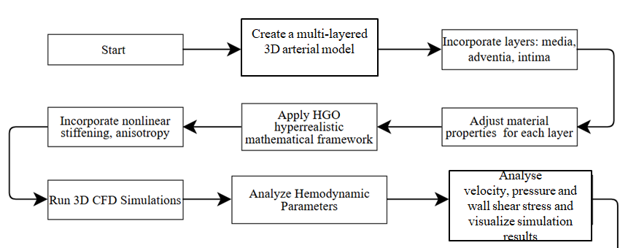
Flow Chart
Generate Dataset
3

Slide 4
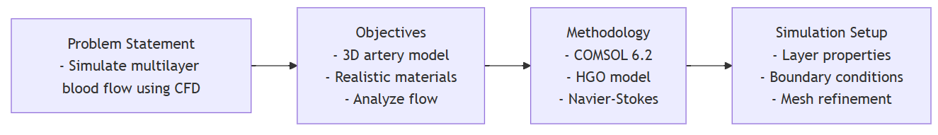
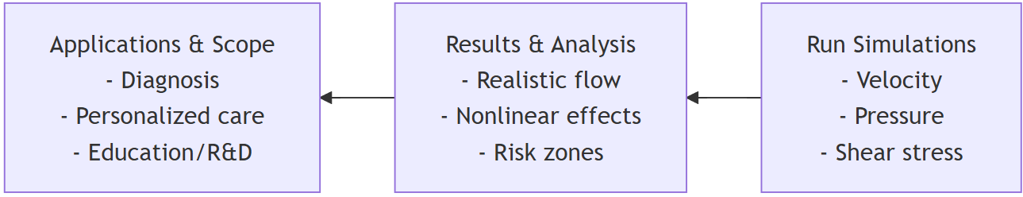
Review 1
4

Slide 5
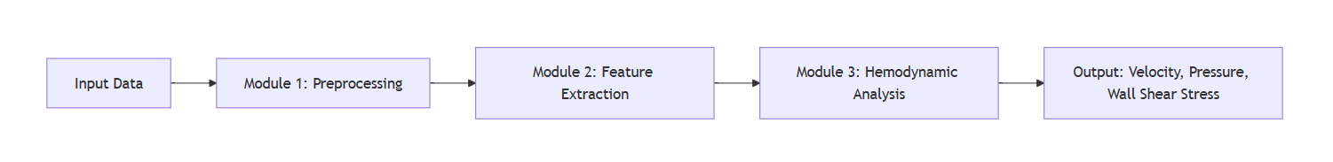
System / Algorithm Design
Input Data
3D artery geometry, layer properties, boundary conditions
Module 1: Preprocessing
Mesh generation, material assignment, setup of flow conditions
Module 2: Feature Extraction
Extract wall properties, blood flow parameters, layer segmentation
Module 3: Hemodynamic Analysis
Solve Navier-Stokes + FSI, simulate blood flow & wall deformation
Output
Velocity profiles
Pressure gradients
Wall shear stress (WSS)
5

Slide 6
System / Algorithm Design
Tools used : COMSOL 6.2 & COMSOL 6.3 , Blender Material : Blood vessel Flow : Laminar flow Time Dependent
6

Slide 7
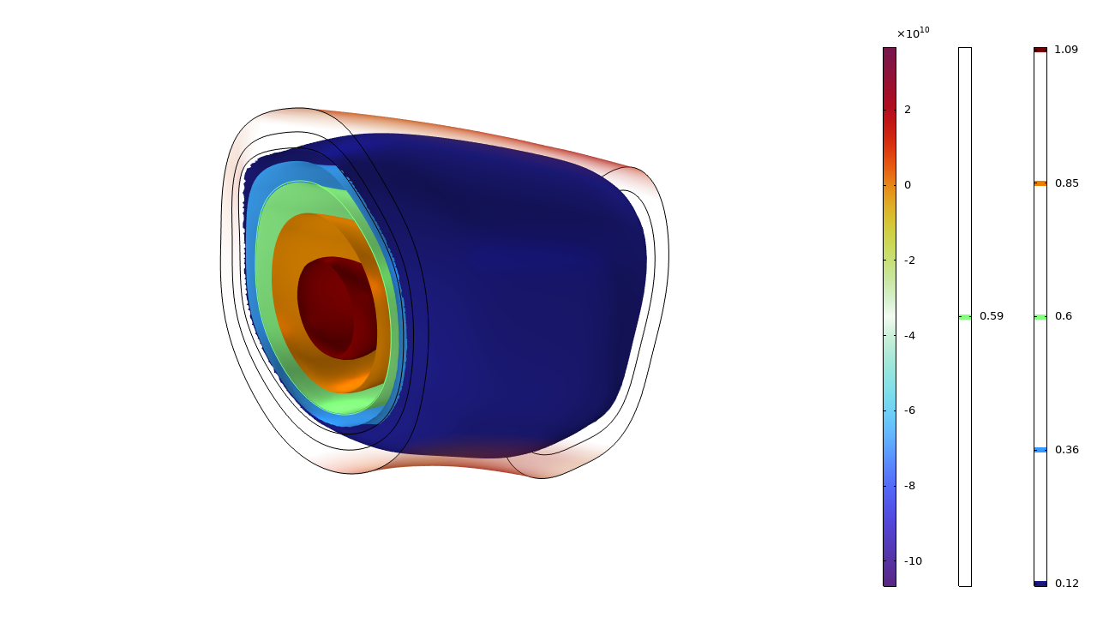
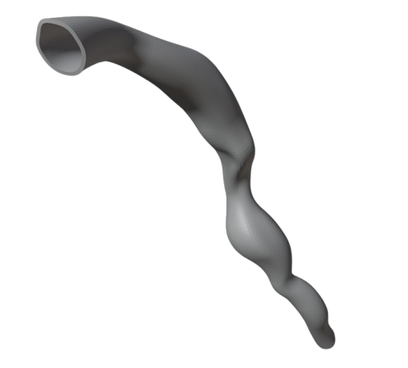
Implementation
Sliced Aorta
7

Slide 8
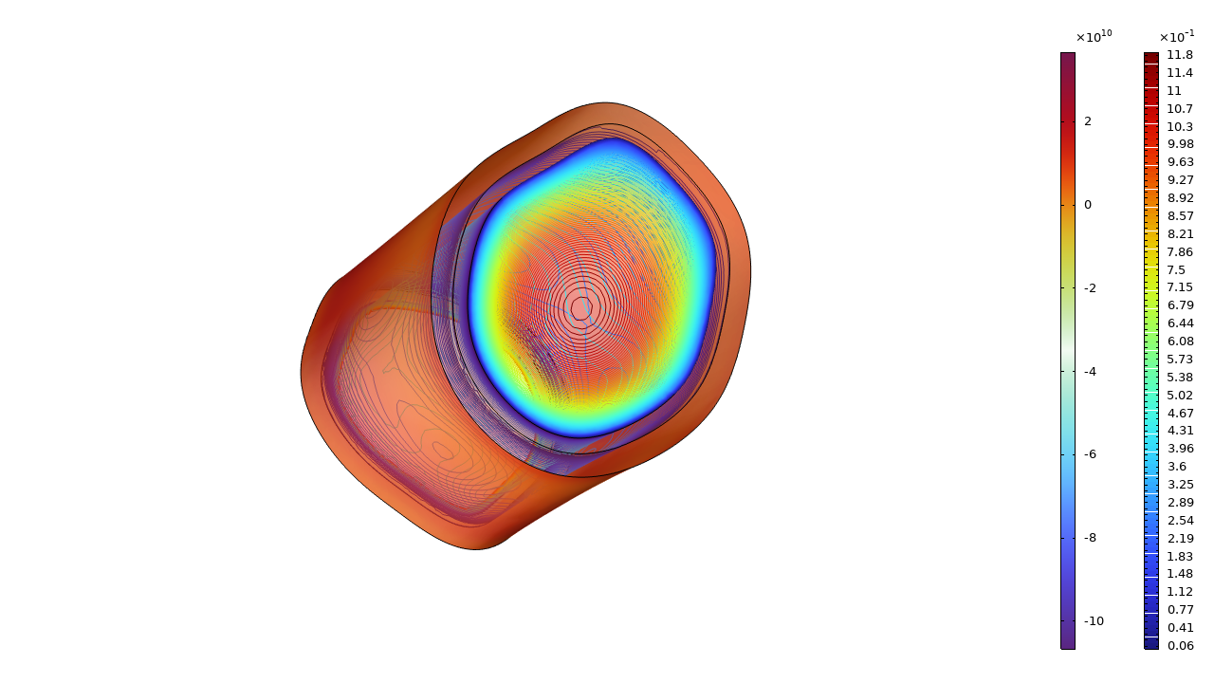
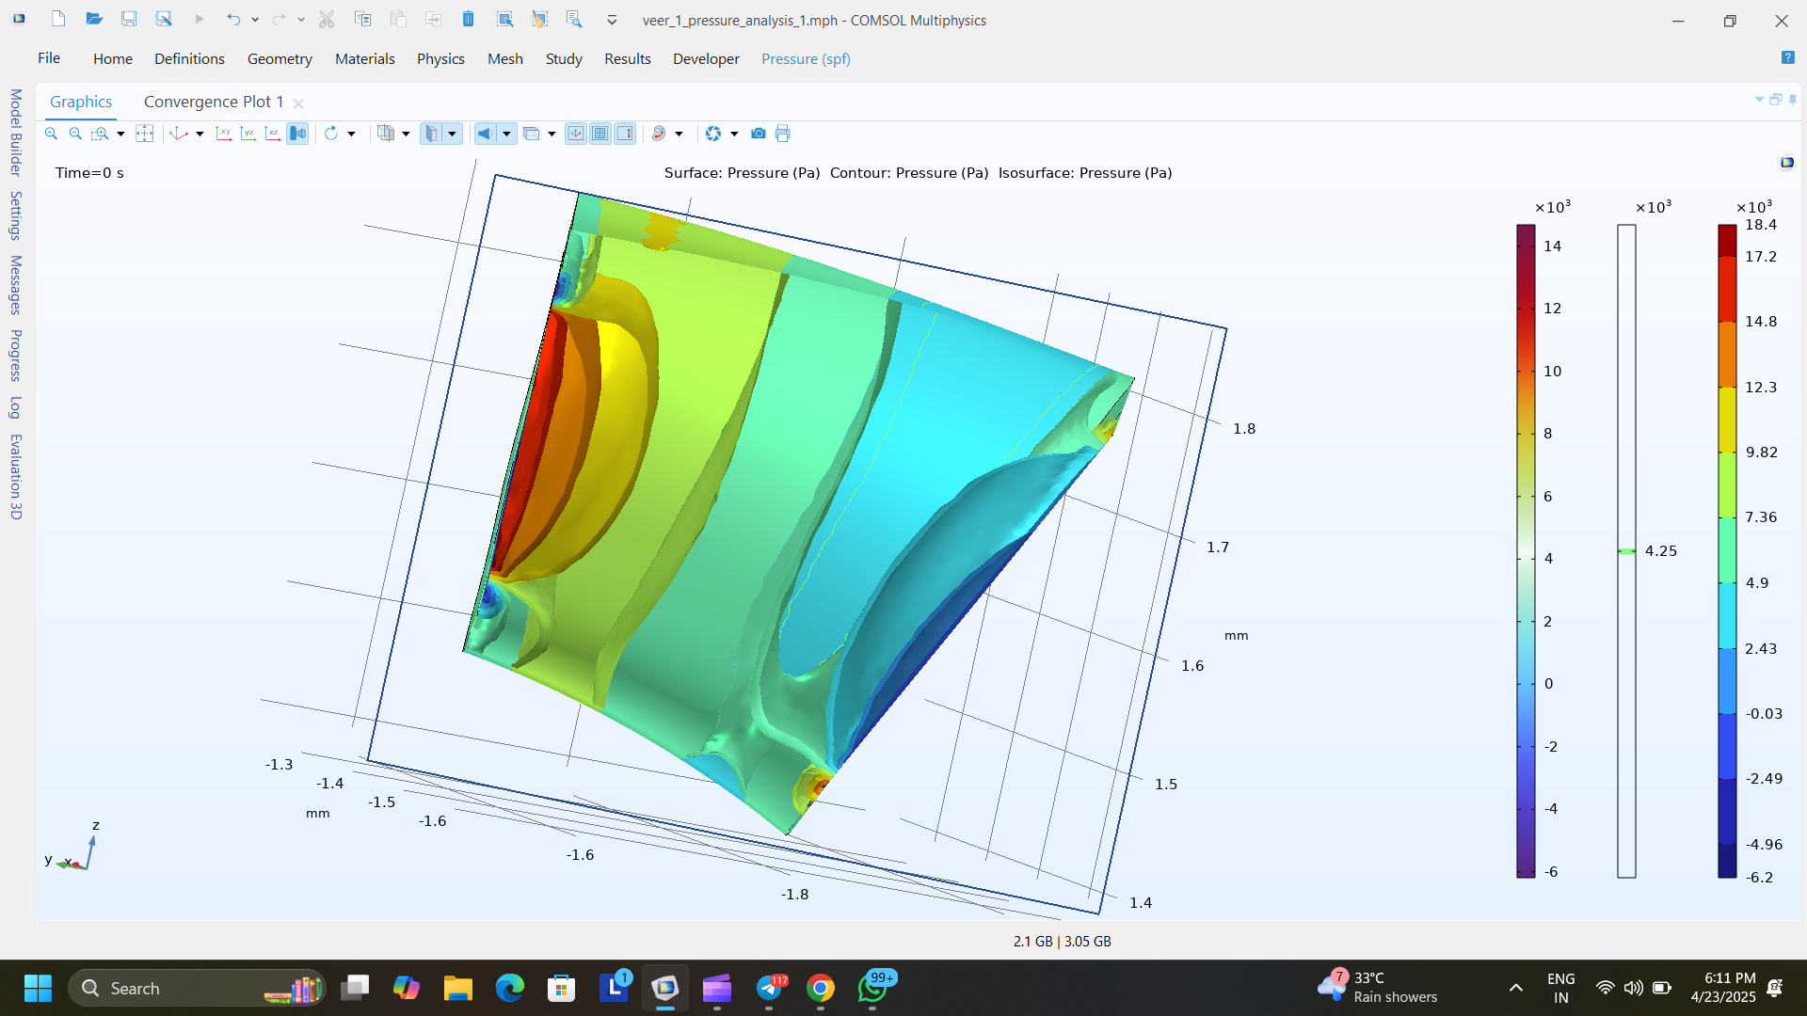
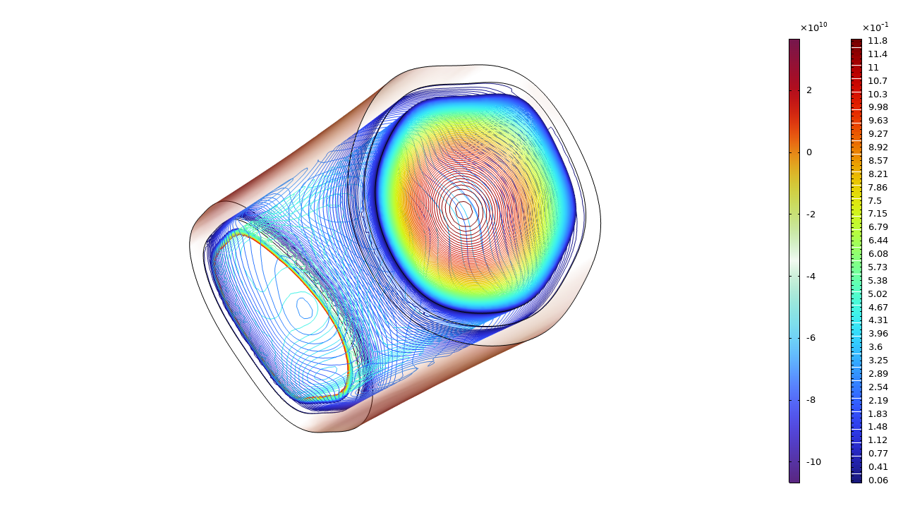
Module Testing and Intermediate Analysis
Pressure on the layers of Aorta
8

Slide 9
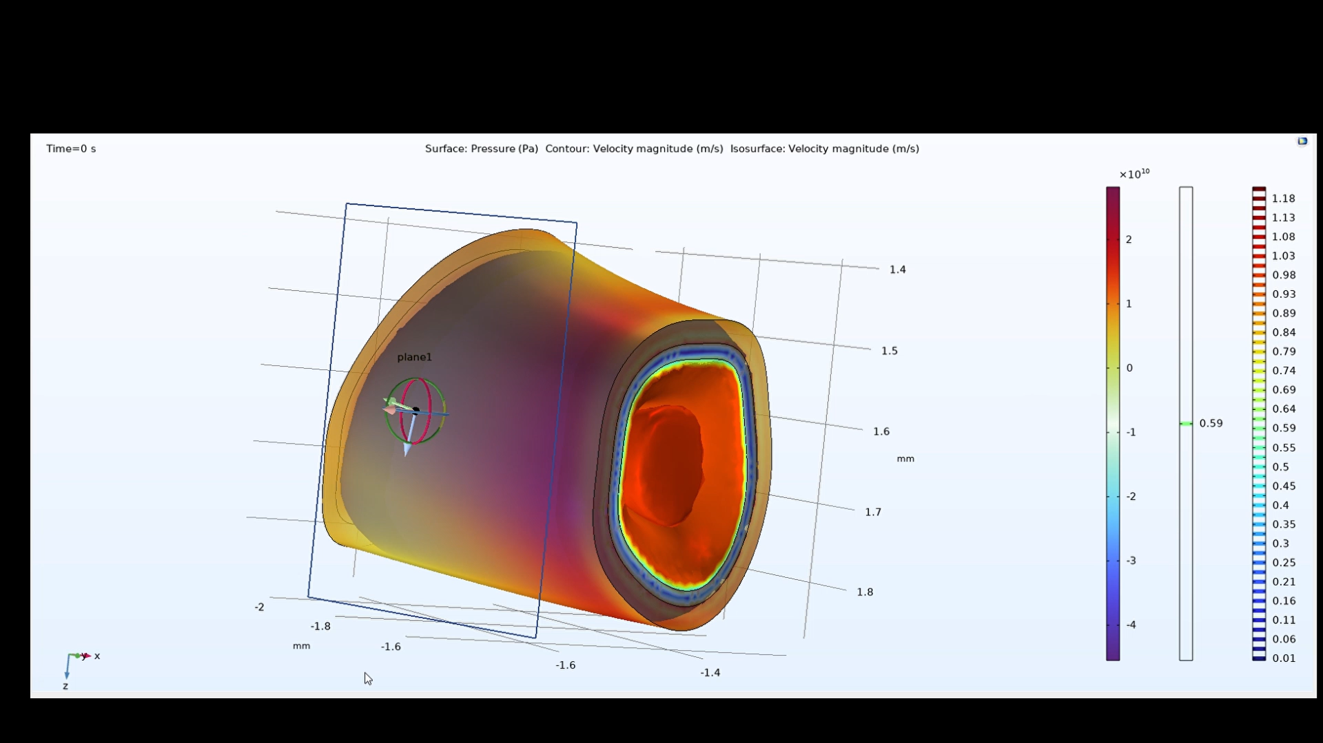
Implementation
9

Slide 10
THANK YOU
10

